Slide 1

Weekly Review
09/02/21
Tasks
Talk to Marvin, Pol about Simulation✅
Check feasibility of model free approach versus model based✅
Run the official repository❌
Additional
Forked the repo and added detailed Installation instructions in Readme ✅
Doubts / Queries
To-Do Items for Next Week
Understand the existing repository completely
Code Soft Actor Critic from scratch
Literature Review from other papers
To-Do Later
Update overall plan
Testing various simulation platforms & selecting one
To-Do Later
Update overall plan
Testing various simulation platforms & selecting one
TO-DO LATER
Update overall plan
Testing various simulation platforms & selecting one

Slide 2
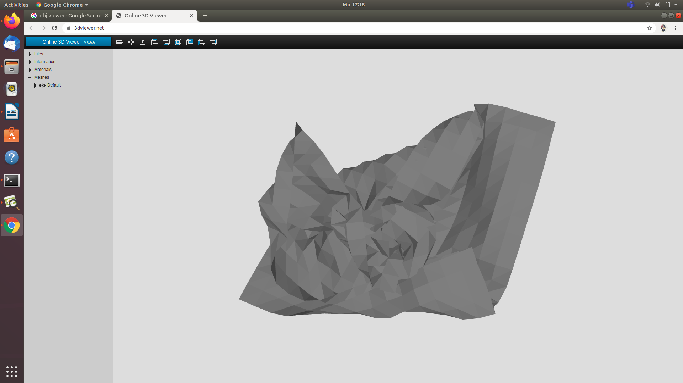
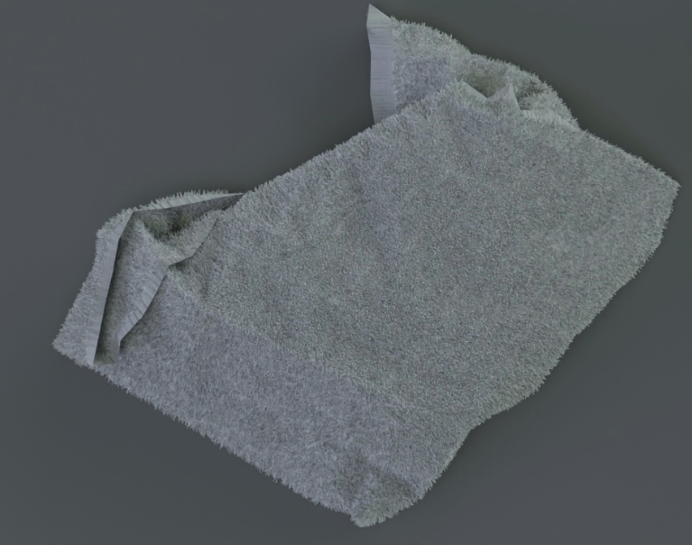
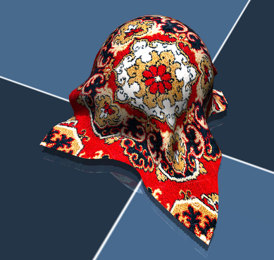
Weekly Review
09/02/21
Task details
Talk to Marvin, Pol about Simulation✅
Mesh
Rendering
Mujoco
Not needed : use mujoco model initially
(Need faster simulation and huge dataset)
For later use : sim-to-real transfer

Slide 3
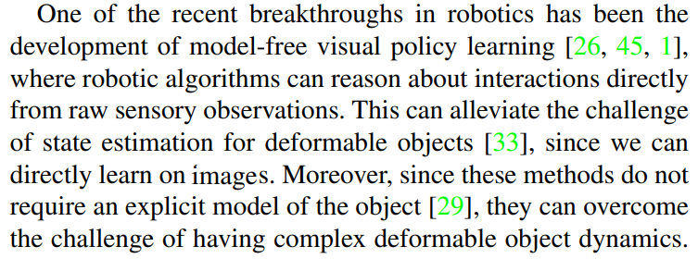
Weekly Review
09/02/21
Task details
Check feasibility of model free approach versus model based✅
Pick points are selected on binary segmentation of the cloth image
Reward is also computed from the segmentation

Slide 4
Weekly Review
09/02/21
Task details
Run the official repository❌
Possible issues –
Environment not set up correctly
Not enough computation on laptop
Need better understanding of the repository !!!

Slide 5
Weekly Review
09/02/21
Tasks
Talk to Marvin, Pol about Simulation✅
Check feasibility of model free approach versus model based✅
Run the official repository❌
Additional
Forked the repo and added detailed Installation instructions in Readme ✅
Doubts / Queries
To-Do Items for Next Week
Understand the existing repository completely
Code Soft Actor Critic from scratch
Literature Review from other papers
To-Do Later
Update overall plan
Testing various simulation platforms & selecting one
To-Do Later
Update overall plan
Testing various simulation platforms & selecting one
TO-DO LATER
Update overall plan
Testing various simulation platforms & selecting one

